Slide 1
2018 RTEP Report
Key Maps, Tables & Figures
The following set of slides provides key information from PJM’s 2018 RTEP cycle. The slides are provided for the reader’s own communications needs.

Slide 2
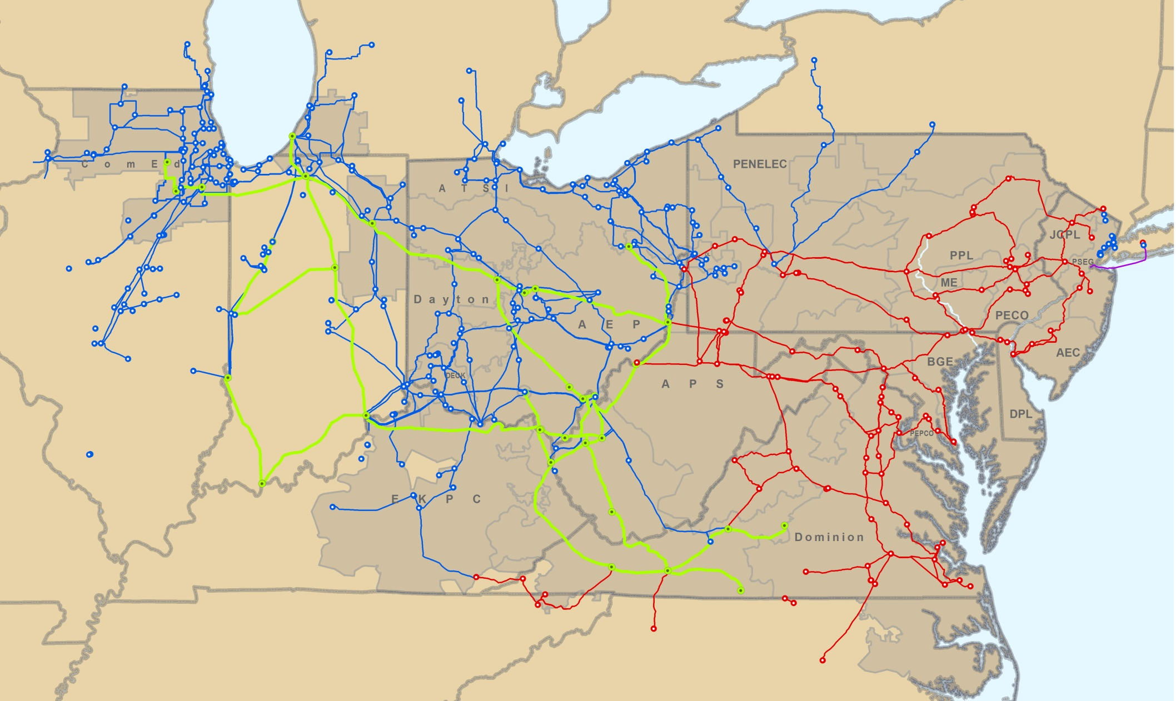
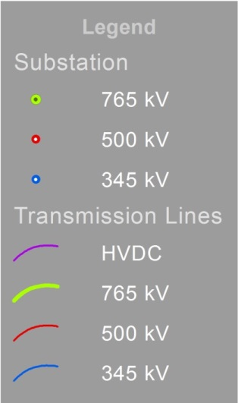
Backbone Map

Slide 3
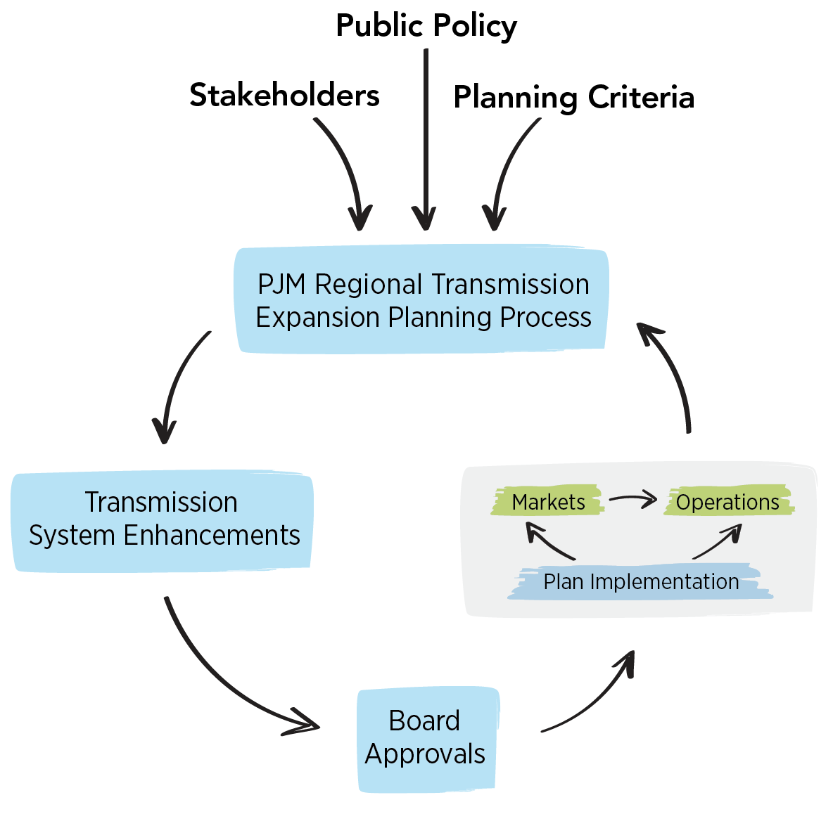
RTEP Process – RTO Perspective

Slide 4
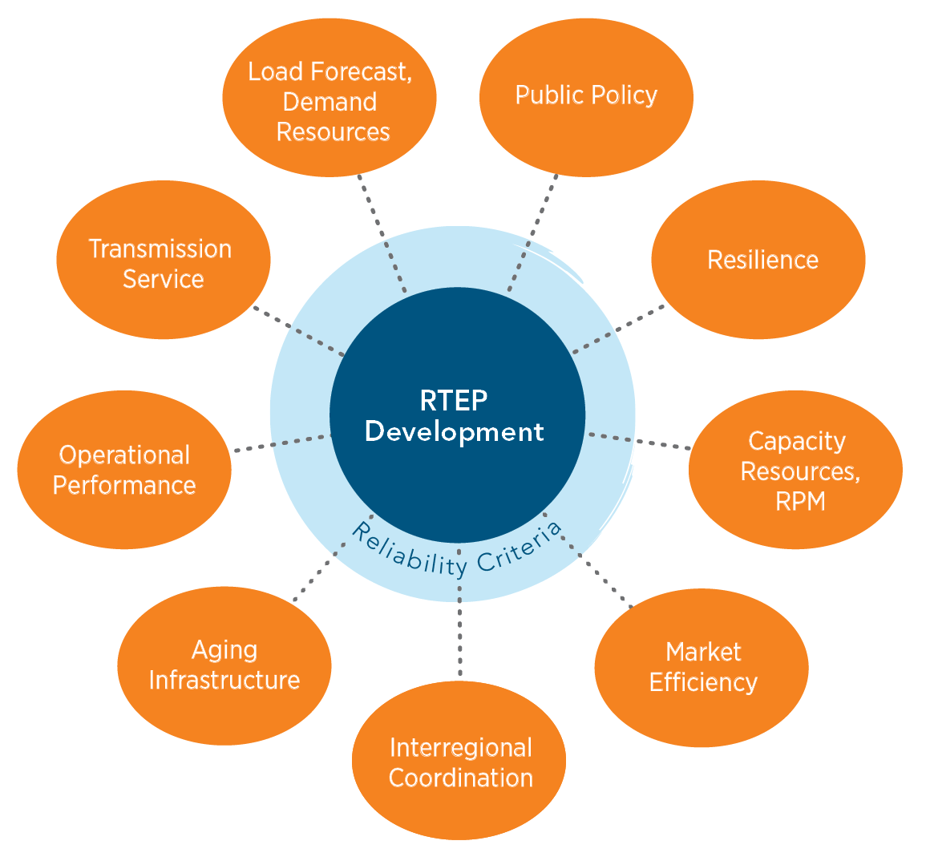
System Enhancement Drivers

Slide 5
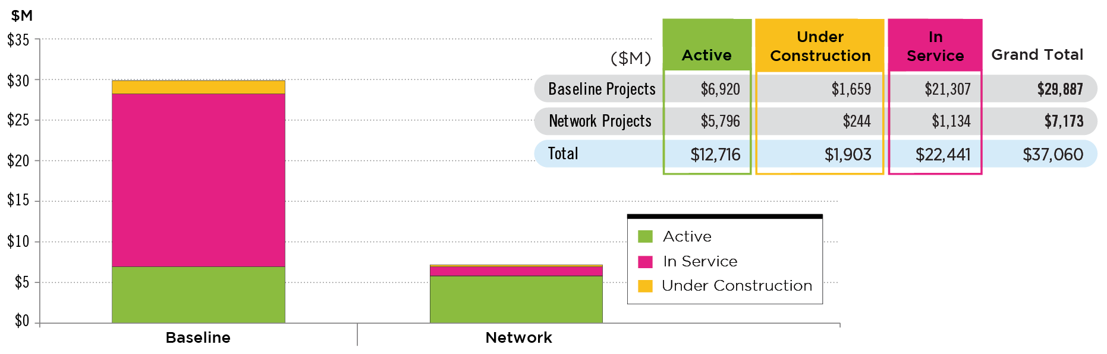
Approved RTEP Projects (December 31, 2018)
NOTE: Since 1999, the PJM Board has approved transmission system enhancements totaling $37.1 billion. Of this, $29.9 billion represents baseline projects to ensure compliance with NERC, regional and local transmission owner planning criteria and to address market efficiency congestion relief. An additional $7.2 billion represents network facilities to enable more than 85,000 MW of new generation to interconnect reliably.

Slide 6
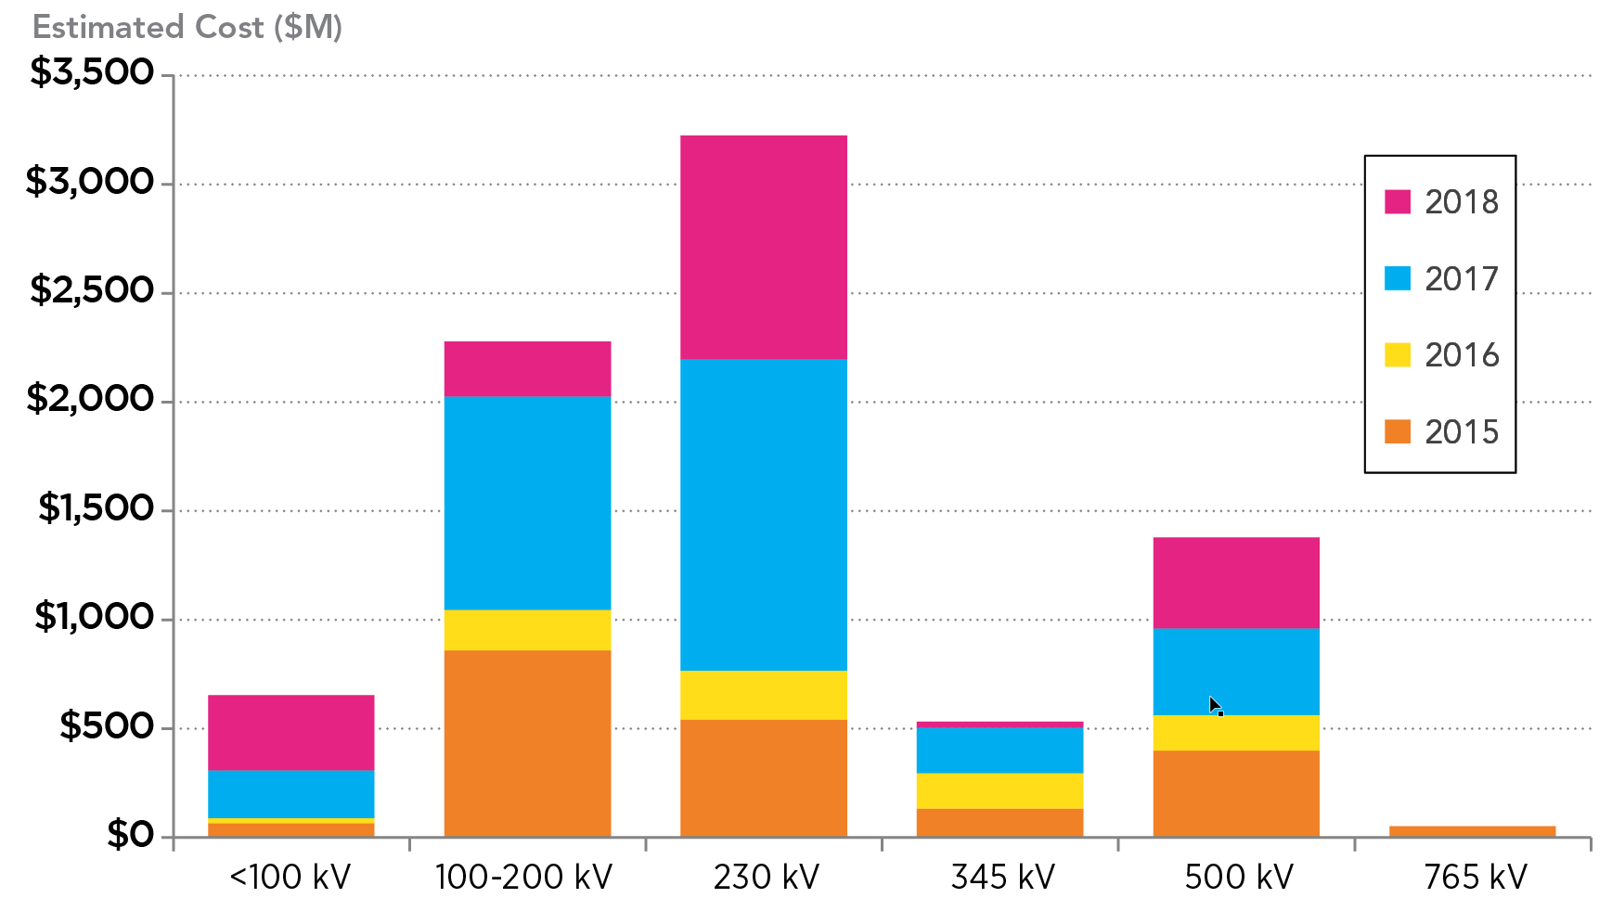
Approved Baseline Projects by Voltage – 2015-2018

Slide 7
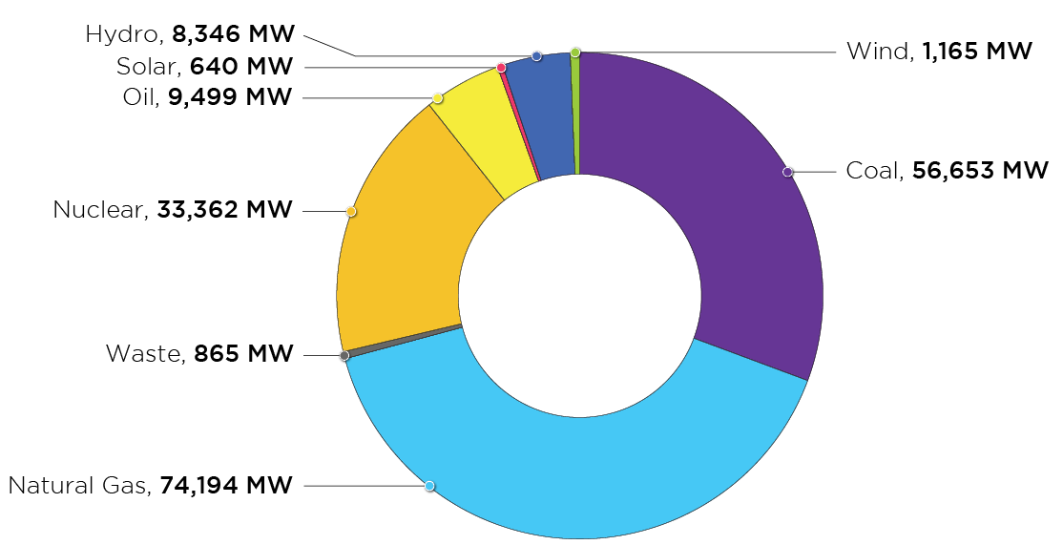
PJM Existing Installed Capacity Mix RPM Eligibility Capacity (December 31, 2018)
As of Jan 31, 2018

Slide 8
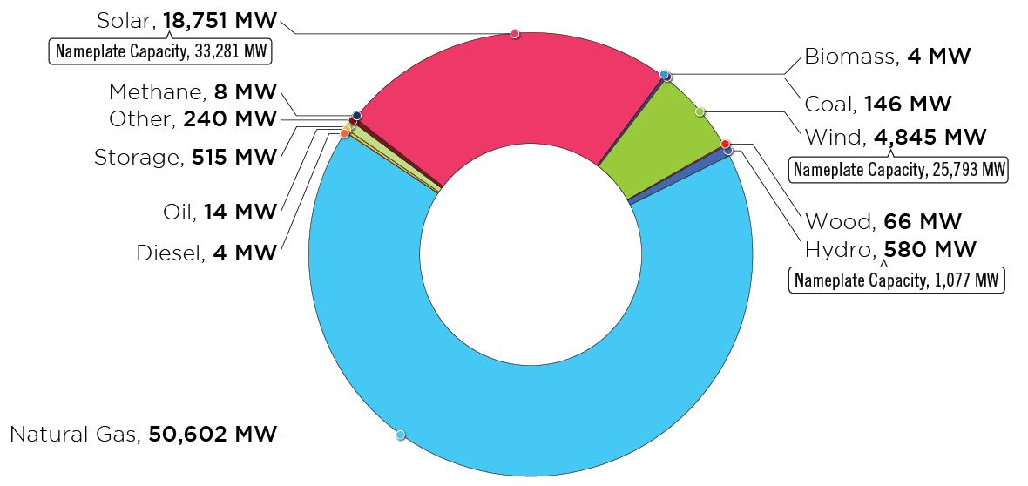
PJM Queued Generation Fuel Mix-
Requested Capacity Interconnection Rights
(December 31, 2018)
NOTE: Nameplate Capacity
represents a generator’s rated
full power output capability.

Slide 9
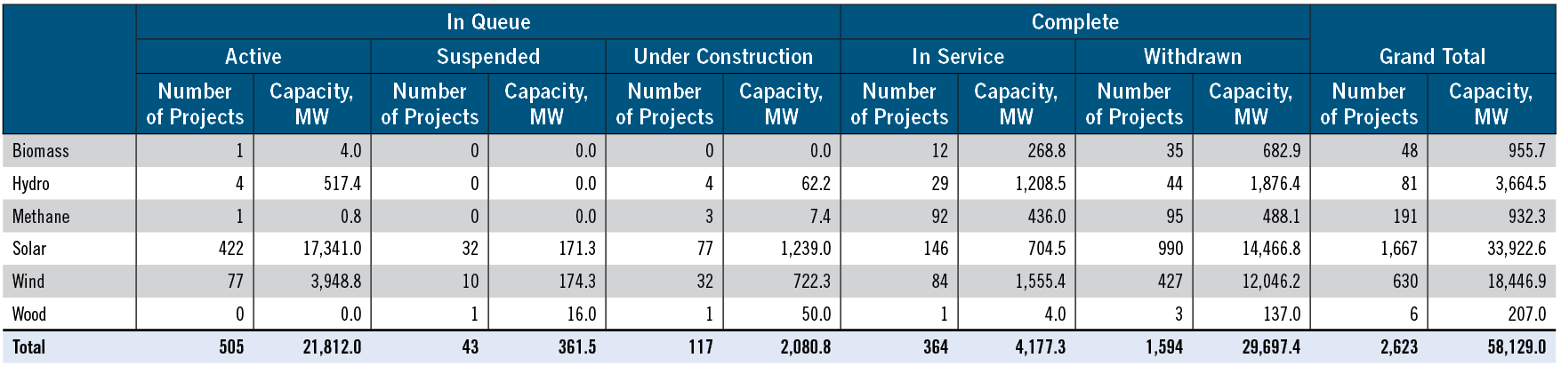
Requested Capacity Interconnection Rights,
Renewable Fuels (December 31, 2018))

Slide 10
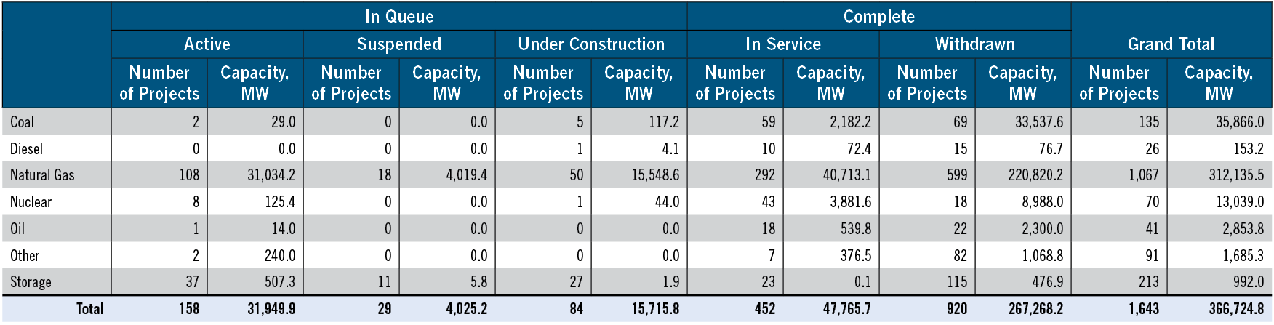
Requested Capacity Interconnection Rights,
Non-Renewable Fuels (December 31, 2018))

Slide 11
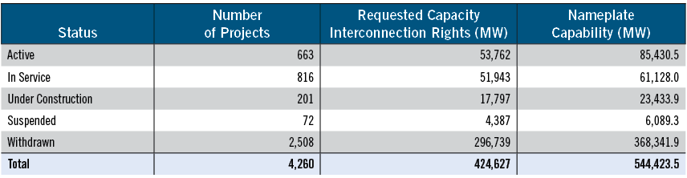
Queue Status Totals (December 31, 2018))

Slide 12
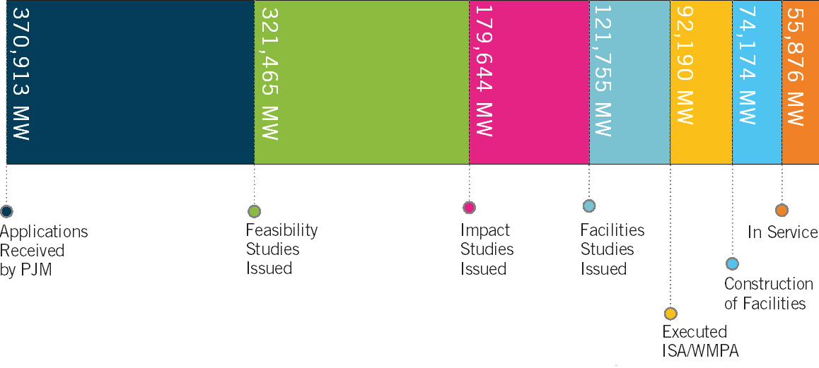
Queued Generation Progression – Requested Capacity Rights
(December 31, 2018)

Slide 13
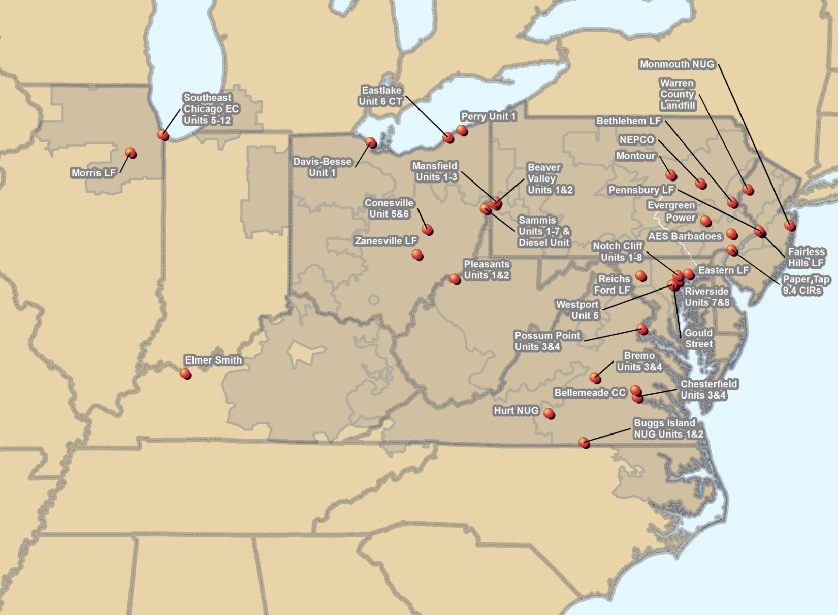

PJM Generator Deactivations Received
January 1, 2018 through December 31, 2018

Slide 14
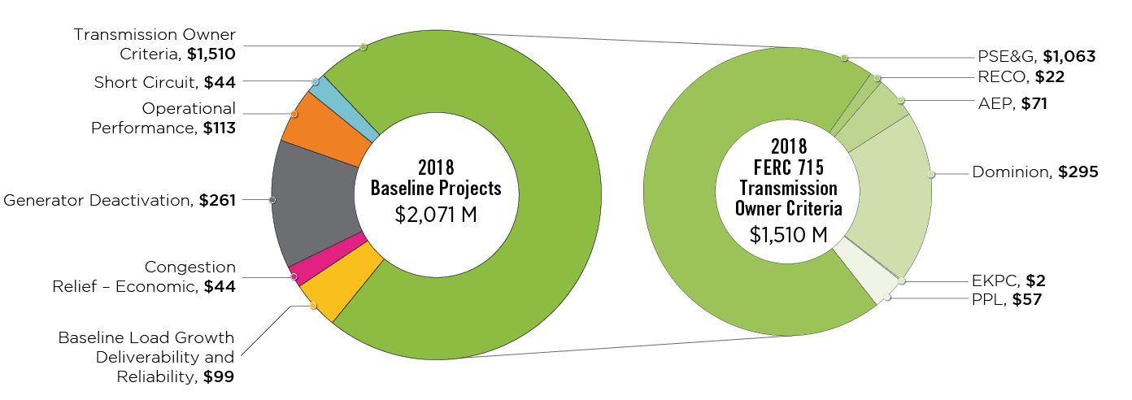
2018 RTEP Baseline Projects by Driver

Slide 15
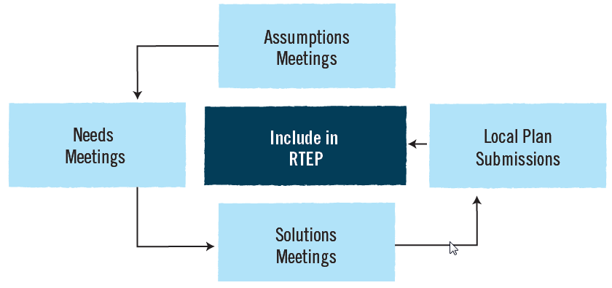
Attachment M3 Process for Supplemental Projects

Slide 16
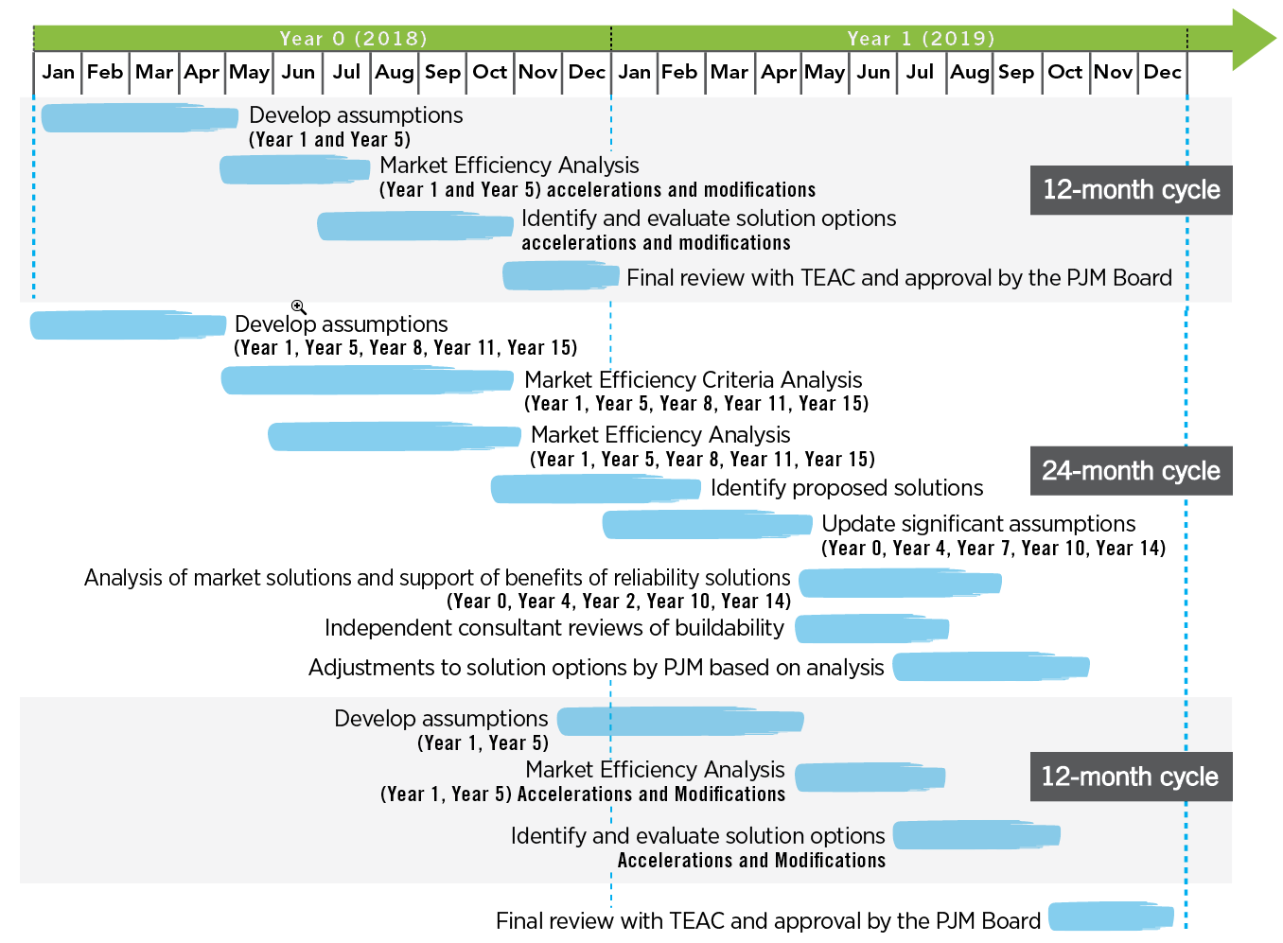
Market Efficiency 24-Month Cycle

Slide 17
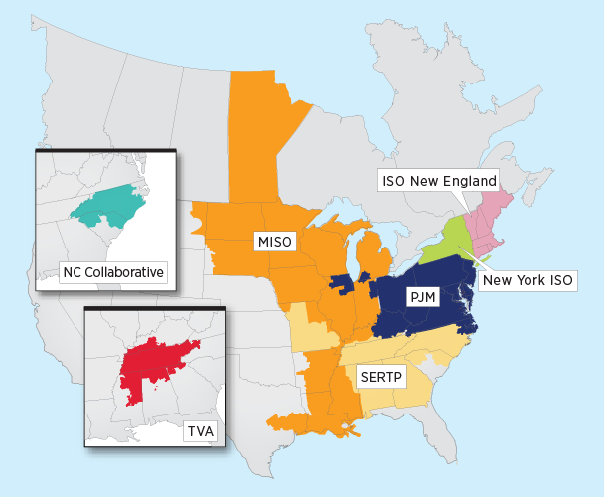
Market Efficiency 24-Month Cycle
NOTE: Ohio Valley Electric Corporation (OVEC) Integration was successfully completed on Dec. 1, 2018.

Slide 18
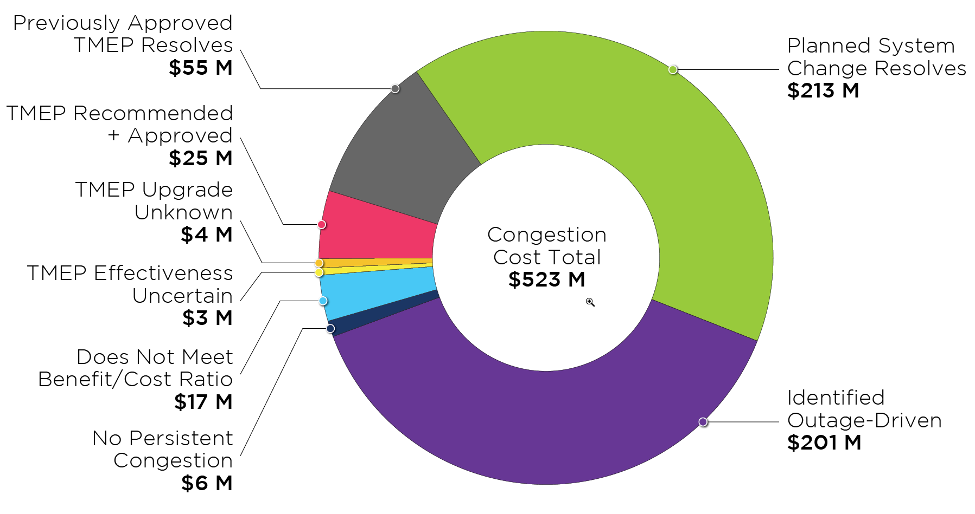
Target Market Efficiency Project Study Results – Congestion Cost

Slide 19
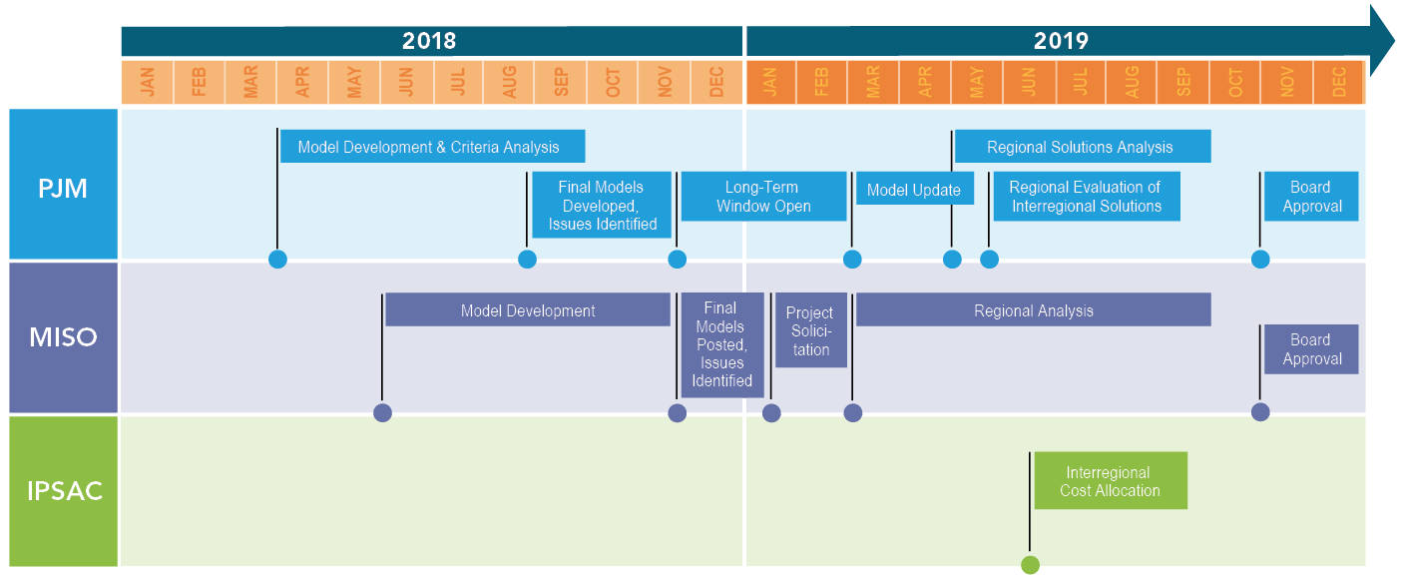
Interregional Market Efficiency Project Study Timeline

Slide 20
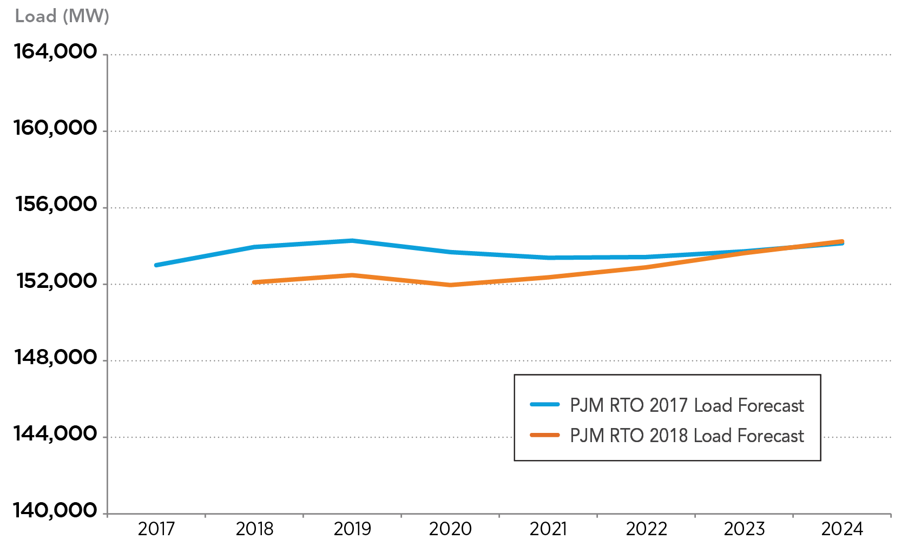
Summer Peak Load Forecast Comparison (2017-2018)

Slide 21
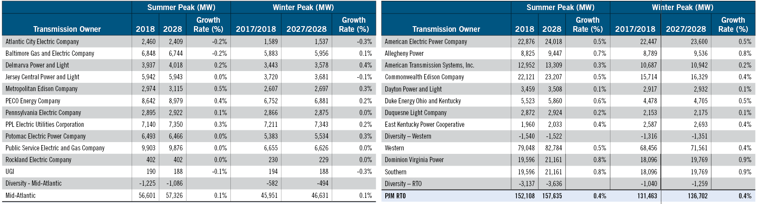
2018 Load Forecast Report

Slide 22
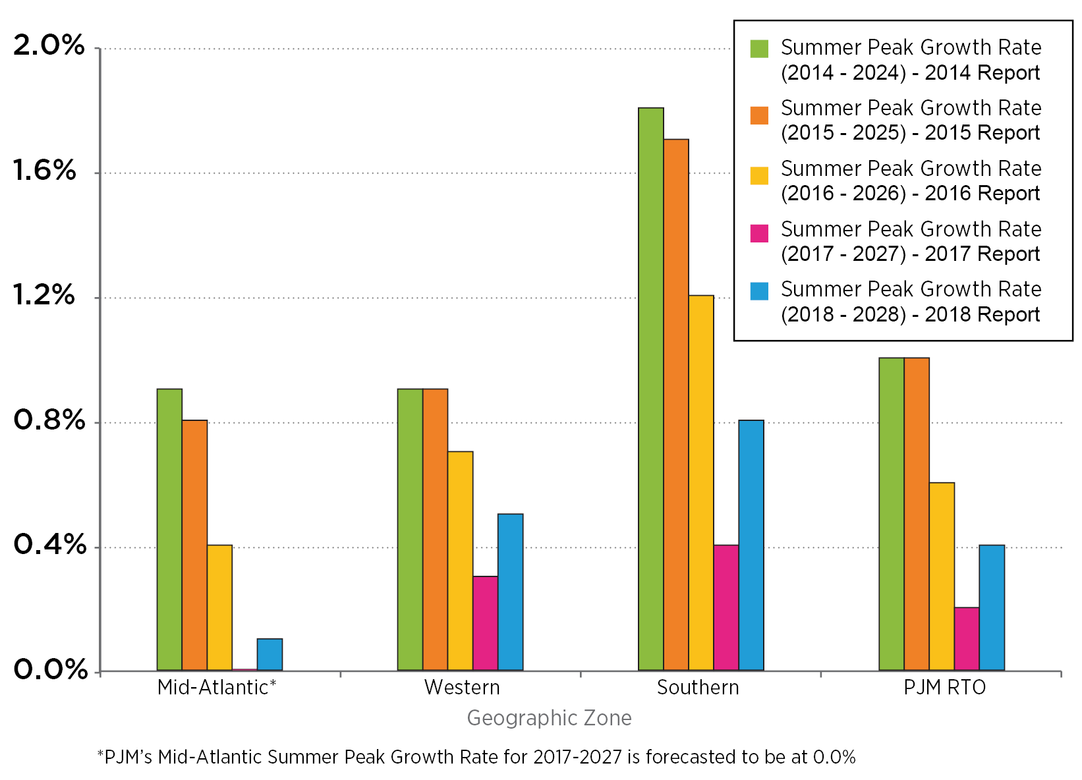
10 Year Summer Peak Growth Rate Comparison 2014-2018

